Slide 1
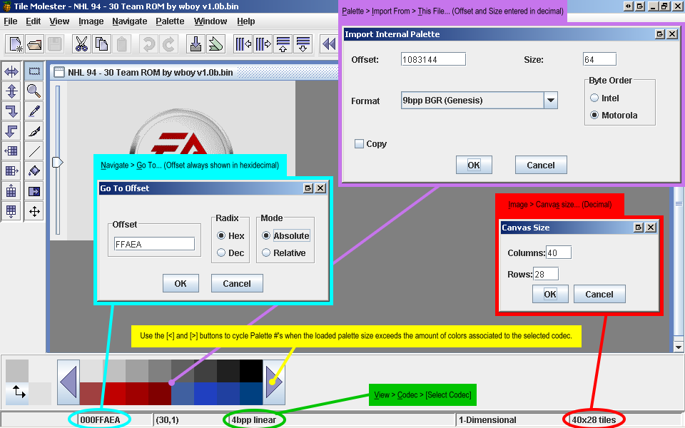
On Screen References

Slide 2
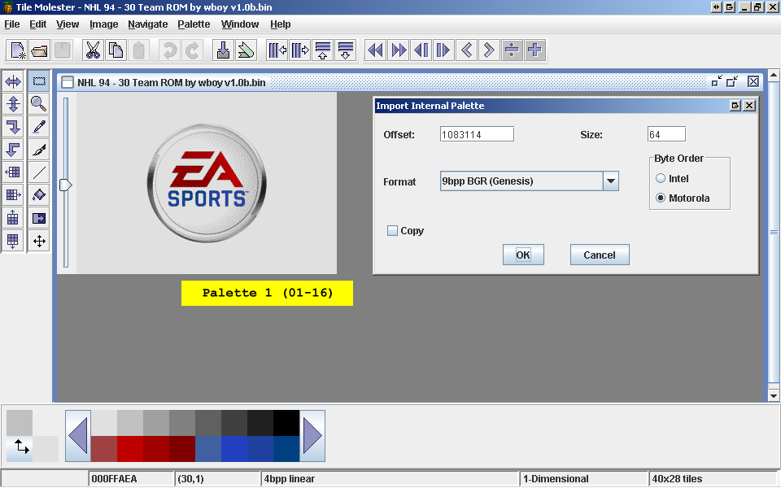
1st Splash Screen
Palette 4 (49-64)

Slide 3
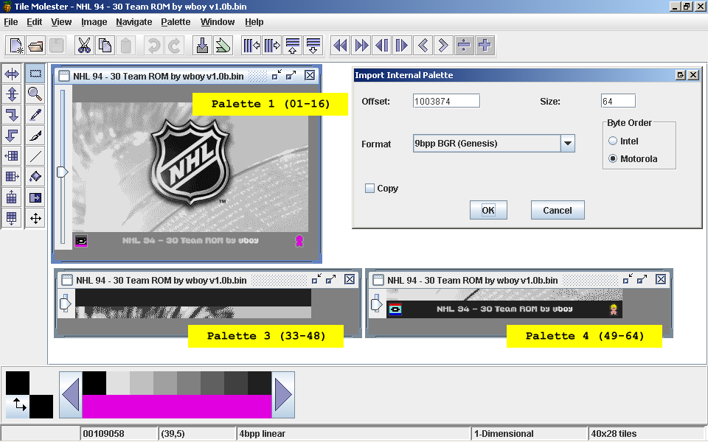
2nd Splash Screen

Slide 4
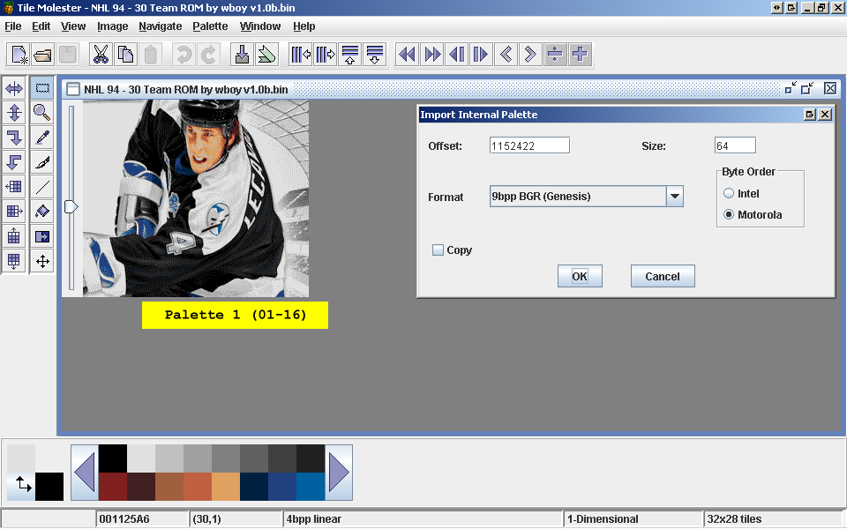
Title Screen Background

Slide 5
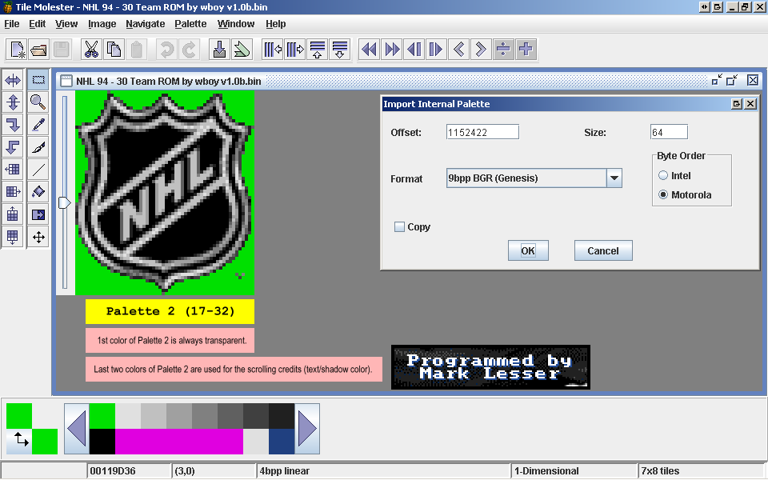
Title Screen

Slide 6
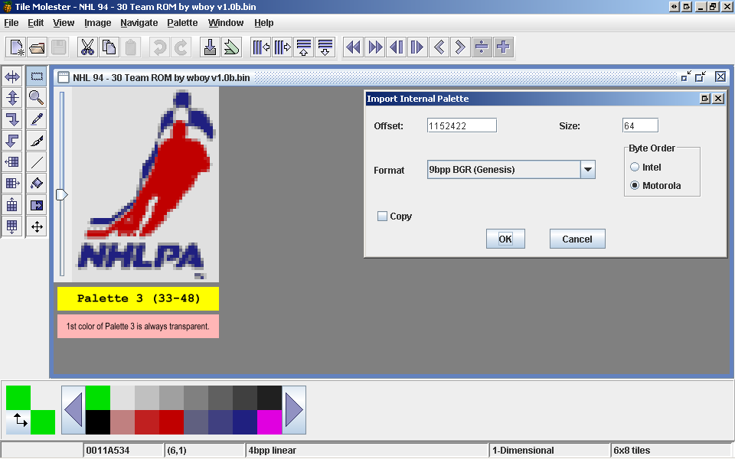
Title Screen – NHLPA Logo

Slide 7
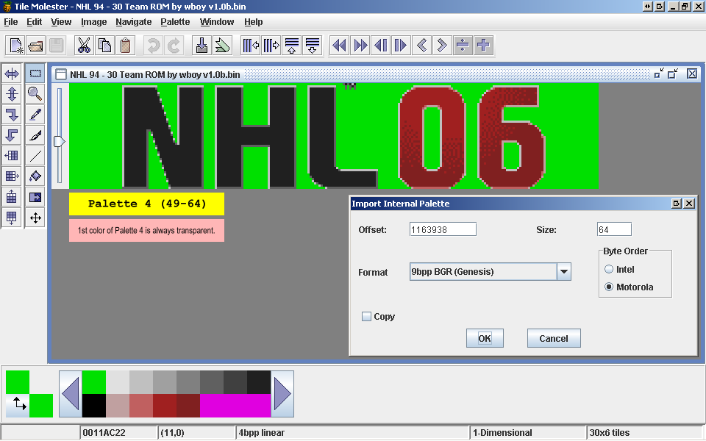
Title Screen NHL06 Logo

Slide 8
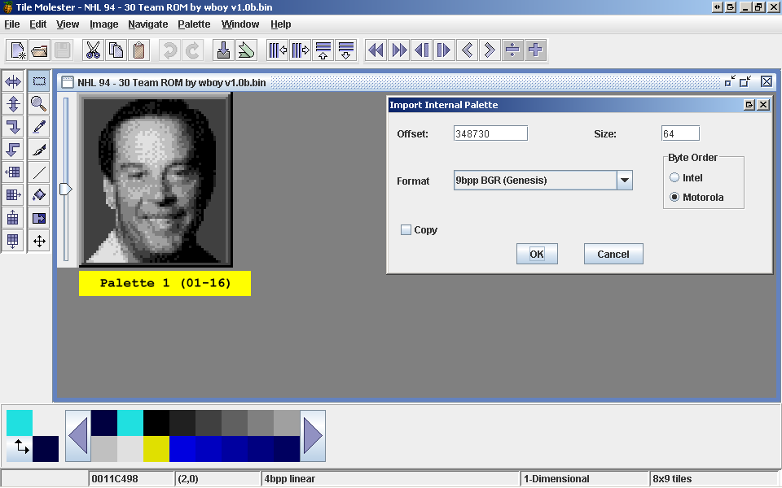
Ron Barr
New Palette Slapshot hack:
1166840, see next page

Slide 9
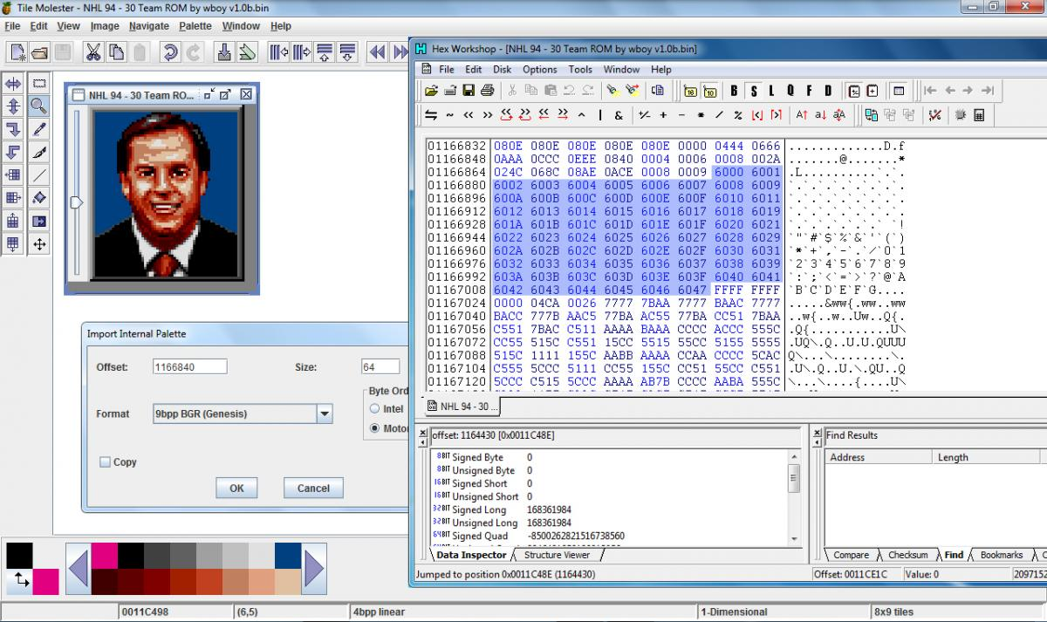
Ron Barr (part 2)
in a hex editor goto 0011CE1C and change the next 0x90 bytes, first number from 0 to 6 (6000 6001 6002 etc.) then open in tile molester and use offset color 1166840 to put original Ron back.
New Palette Slapshot hack:
1166840

Slide 10
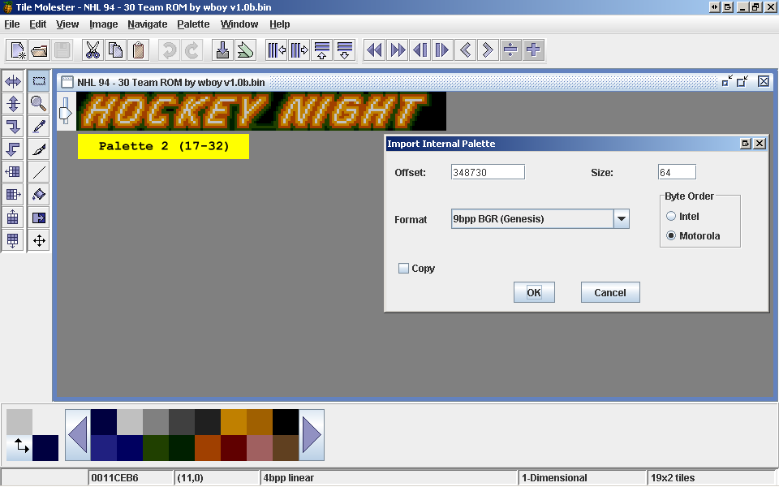
Hockey Night

Slide 11
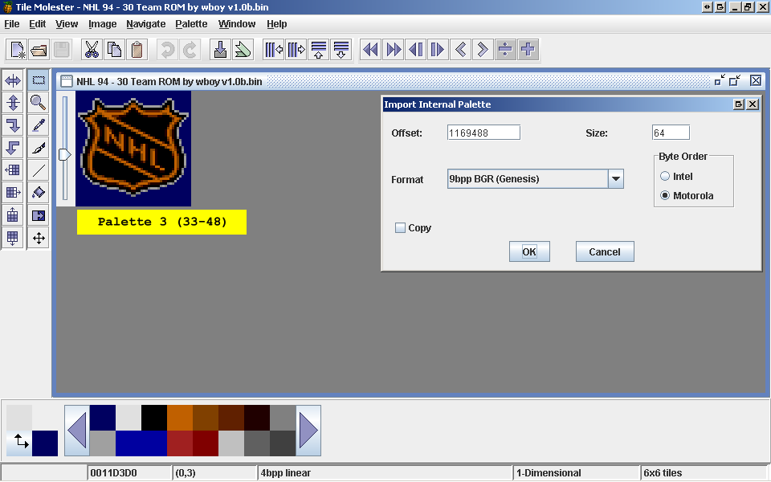
NHL Logo for Player Cards & Records

Slide 12
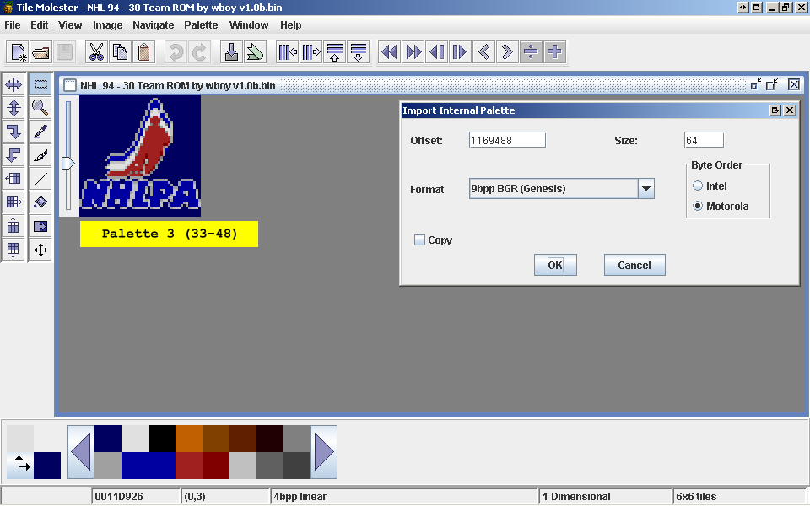
NHLPA Logo for Player Cards & Record

Slide 13
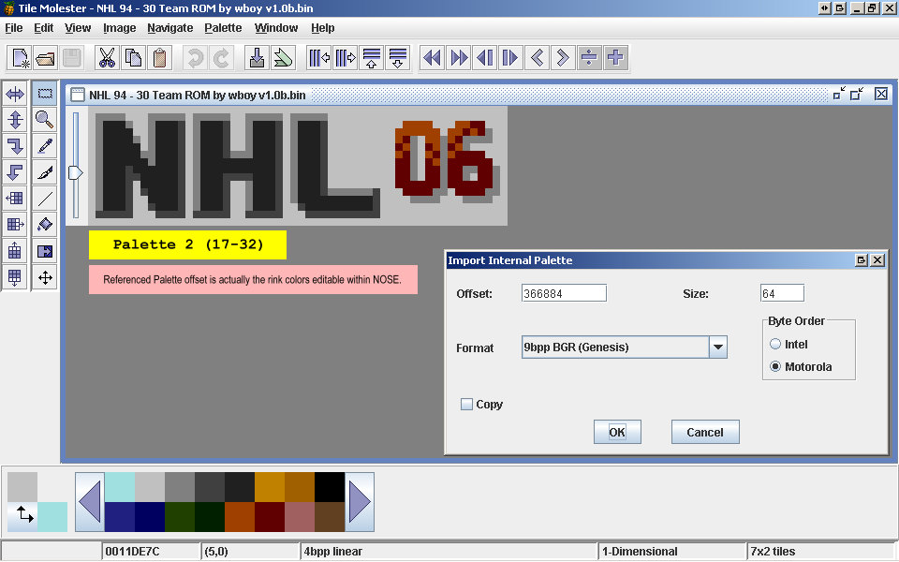
In Game Timer Logo

Slide 14
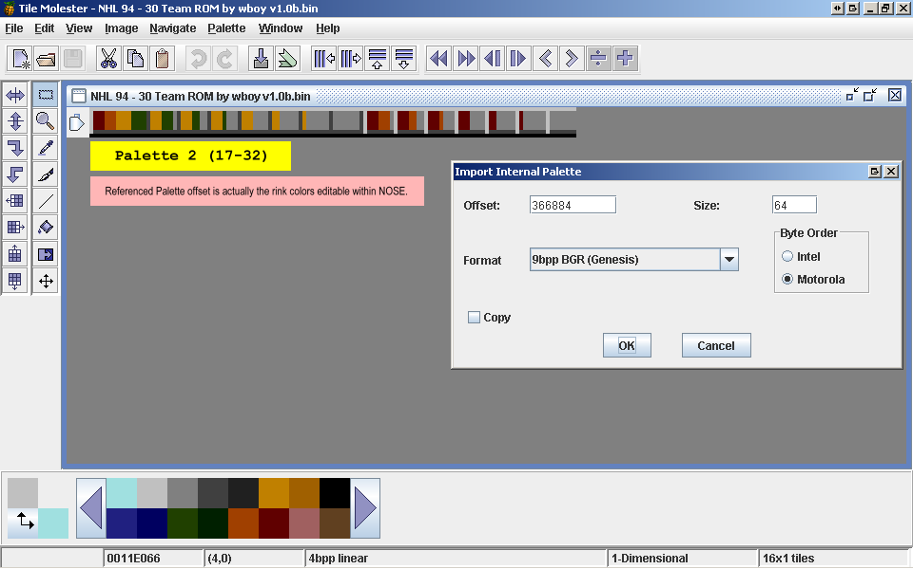
Energy Bar

Slide 15
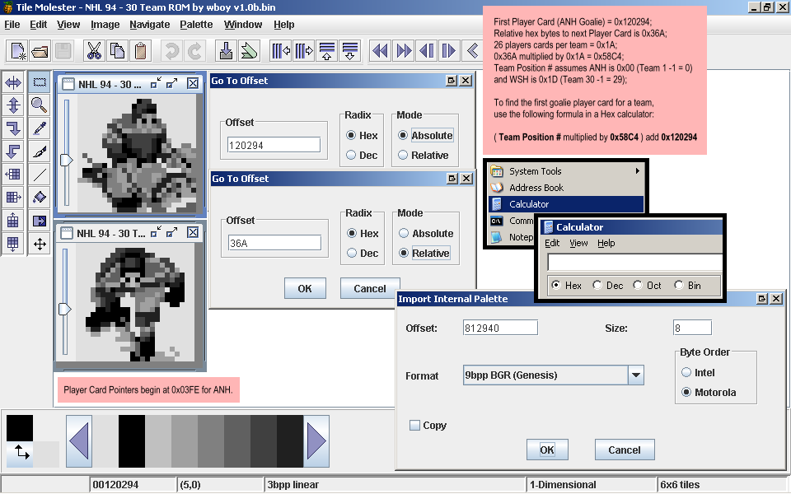
Player Cards

Slide 16
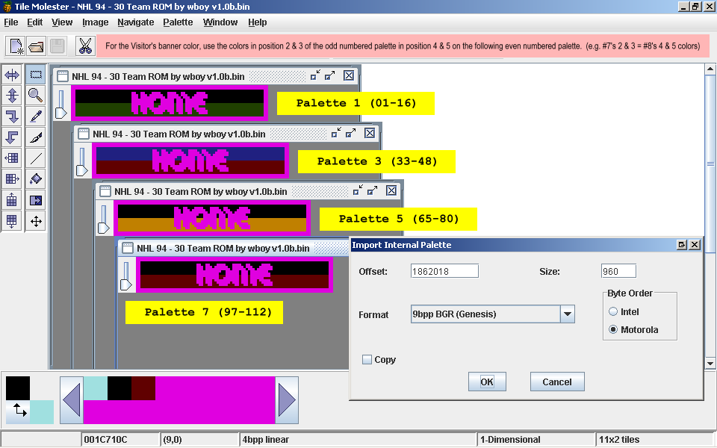
Home & Visitor Team Selection Banner

Slide 17
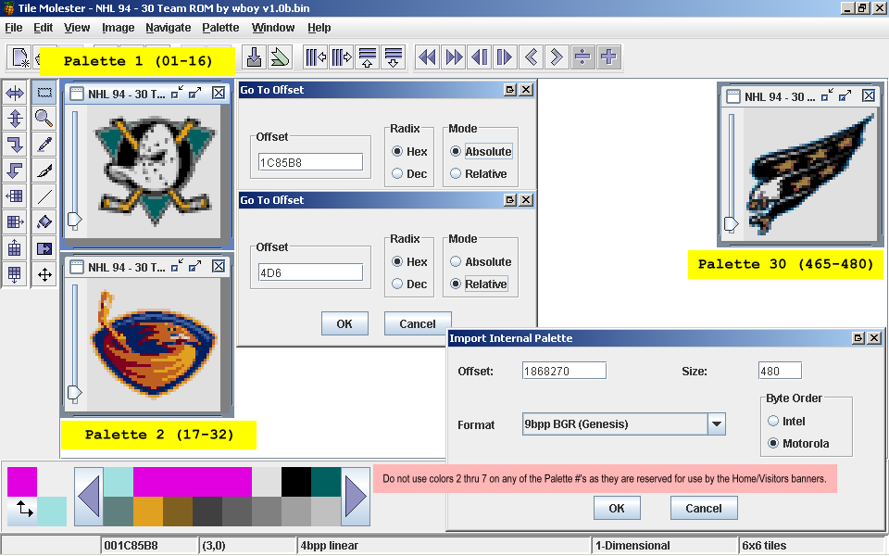
Team Selection Logos

Slide 18
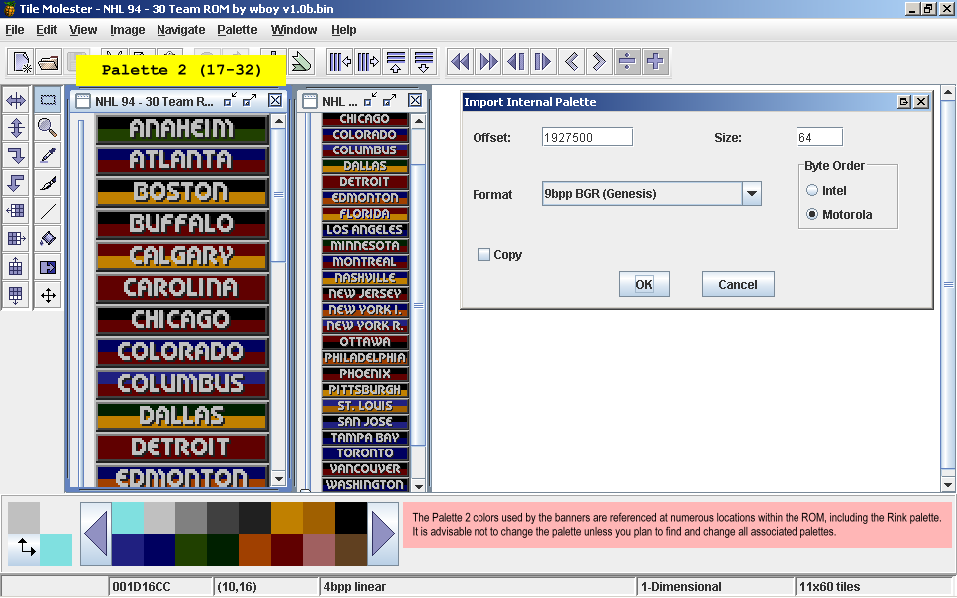
In Game Banners

Slide 19
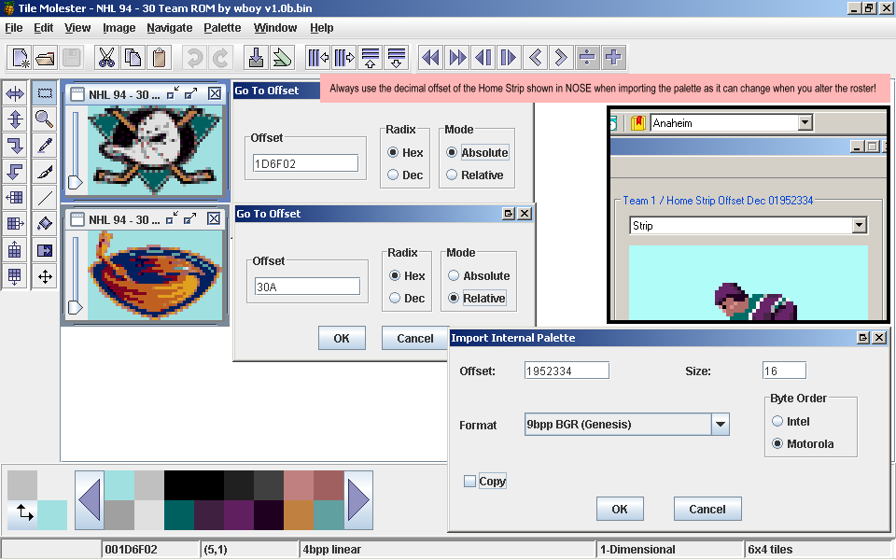
Team Rink Logos

Slide 20
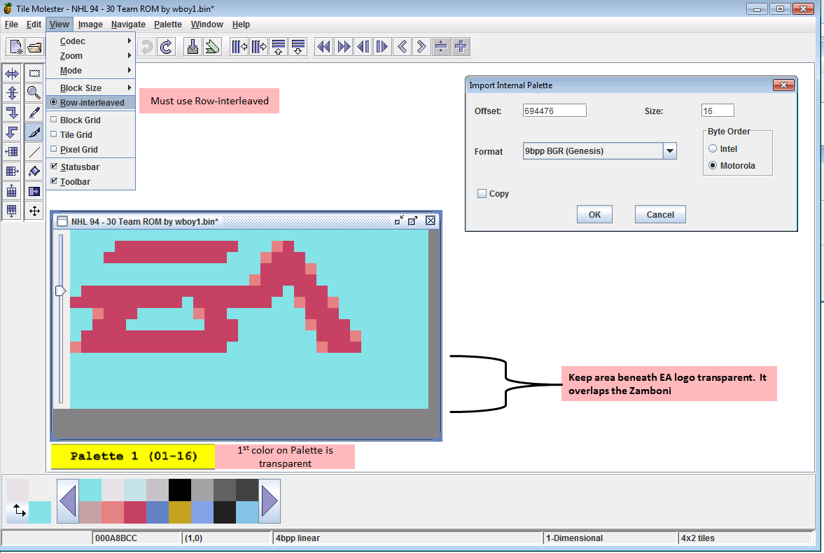
Zamboni Logo

Slide 21

Banner Graphics

Slide 22
Hot Image – 000F5B00 (6x2)
Cold Image – 000F5D26 (6x3) 18th tile not used
Palette 1166840 (16). Slapshot hack
Blue Arrow off screen = 7BA40 (27 tiles)
366884 2nd palette

Slide 23
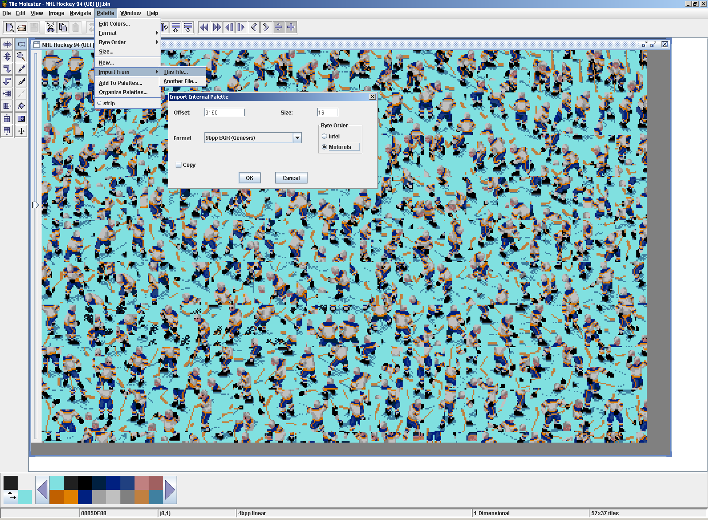

Slide 24
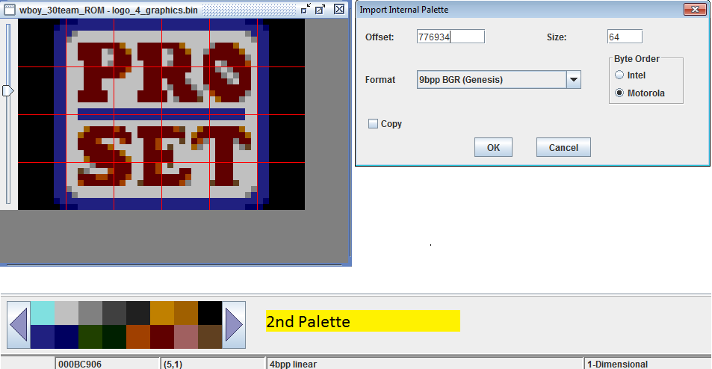
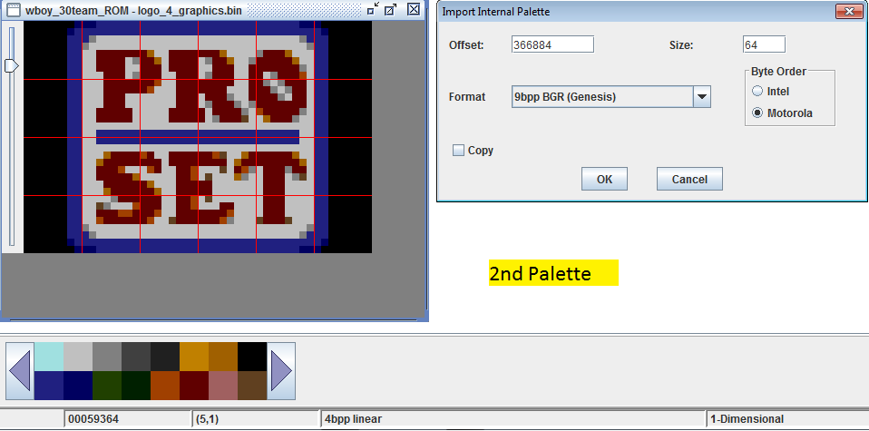
Pro Set Logos

